Slide 1
Algorithm Analysis and Design Divide and Conquer strategy (Heap Sort)
Lecture -18 - 20

Slide 2
Overview
• O(n lg n) worst case-like merge sort.
• Sorts in place-like insertion sort.
• Combines the best of both algorithms.

Slide 3
Heap data structure

Slide 4
Example

Slide 5
Example
Given an array of size N. The task is to sort the array elements by using Heap Sort.
Input:
N=10
Arr[]:{16, 4, 10, 14, 7, 9, 3, 2, 8, 1}
Output: 1 2 3 4 7 8 9 10 14 16

Slide 6
Example

Slide 7
Example
Given an array of size N. The task is to sort the array elements by using Heap Sort.
Input:
N = 10
arr[] = {10,9,8,7,6,5,4,3,2,1}
Output:1 2 3 4 5 6 7 8 9 10

Slide 8
Heap property
For max-heaps (largest element at root), max-heap property: for all nodes i ,
excluding the root, A[PARENT(i )] ≥ A[i ].
For min-heaps (smallest element at root), min-heap property: for all nodes i ,
excluding the root, A[PARENT(i )] ≤ A[i ].

Slide 9
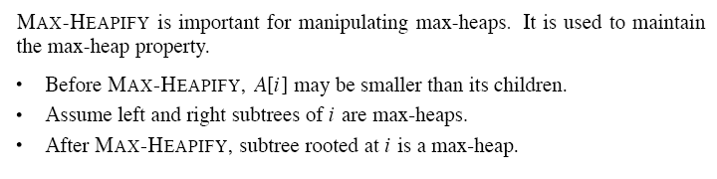
Maintaining the heap property

Slide 11
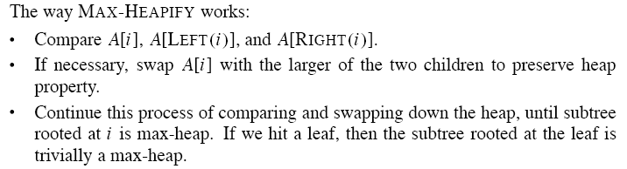

Slide 13
Building a heap

Slide 14
Example
Building a max-heap from the following unsorted array results in the
first heap example.

Slide 16
Correctness
Initialization:
Initialization:we know that each node . . . , n is a leaf, which is the root of a trivial max-heap. Since i = before the first iteration of the for loop, the invariant is initially true.
Maintenance: Children of node i are indexed higher than i , so by the loop invariant, they are both roots of max-heaps. Correctly assuming that i+1, i+2, . . . , n are all roots of max-heaps, MAX-HEAPIFY makes node i a max-heap root. Decrementing i re-establishes the loop invariant at each iteration.
Termination: When i = 0, the loop terminates. By the loop invariant, each node, notably node 1, is the root of a max-heap.

Slide 17
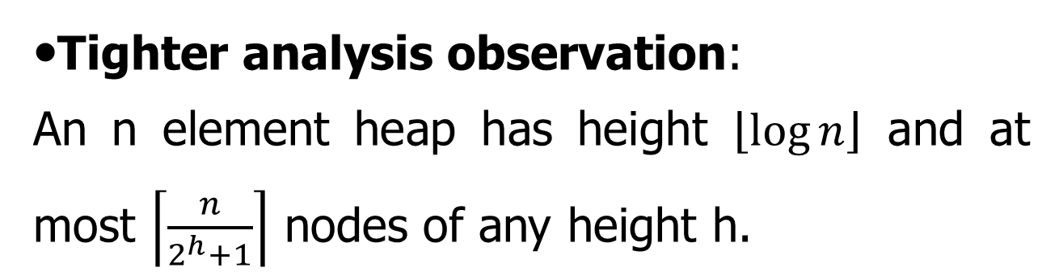
Analysis
• Simple bound: O(n) calls to MAX-HEAPIFY, each of which takes O(lg n) time ⇒ O(n lg n).
•Tighter analysis observation:
An n element heap has height $\left\lfloor \log{n}\right\rfloor$ and at most $\left\lceil \frac{n}{2^{h}+1}\right\rceil$ nodes of any height h.

Slide 18
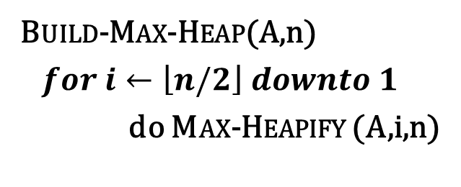
Tighter analysis Proof
Build-Max-Heap(A,n)
$for i←\left\lfloor n/2\right\rfloor downto 1$
do Max-Heapify (A,i,n)
9
6
5
i
0
8
2
1
1 | 2 | 3 | 4 | 5 | 6 | 7 | 8
9 | 6 | 5 | 0 | 8 | 2 | 1 | 3
3

Slide 19
Tighter analysis Proof
For easy understanding, Let us take a complete binary Tree,
The height of a node is the number of edges from the node to the deepest leaf.
The depth of a node is the no of edges from the root of the node.

Slide 20
Tighter analysis Proof
All the leaves are of height 0, therefore there are 8 nodes at height 0.
4 numbers of nodes at height 1.
2 numbers of nodes at height 2.
and one node at height 3.

Slide 21
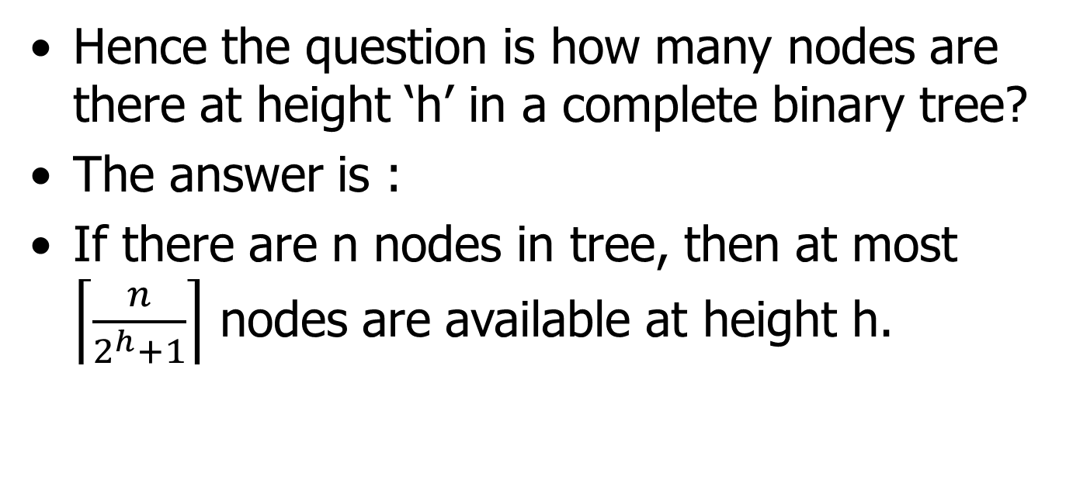
Tighter analysis Proof
Hence the question is how many nodes are there at height ‘h’ in a complete binary tree?
The answer is :
If there are n nodes in tree, then at most $\left\lceil \frac{n}{2^{h}+1}\right\rceil$ nodes are available at height h.

Slide 22
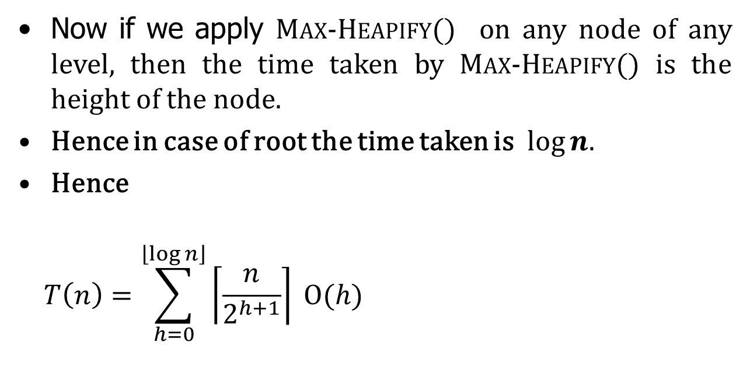
Tighter analysis Proof
Now if we apply Max-Heapify() on any node of any level, then the time taken by Max-Heapify() is the height of the node.
Hence in case of root the time taken is $log⁡n.$
Hence
$$T\left(n\right)=\sum_{h=0}^{\left\lfloor \log{n}\right\rfloor }{\left\lceil \frac{n}{2^{h+1}}\right\rceil }Ο(h)$$
Work done by Max-Heapify() on the number of nodes of height h.

Slide 23
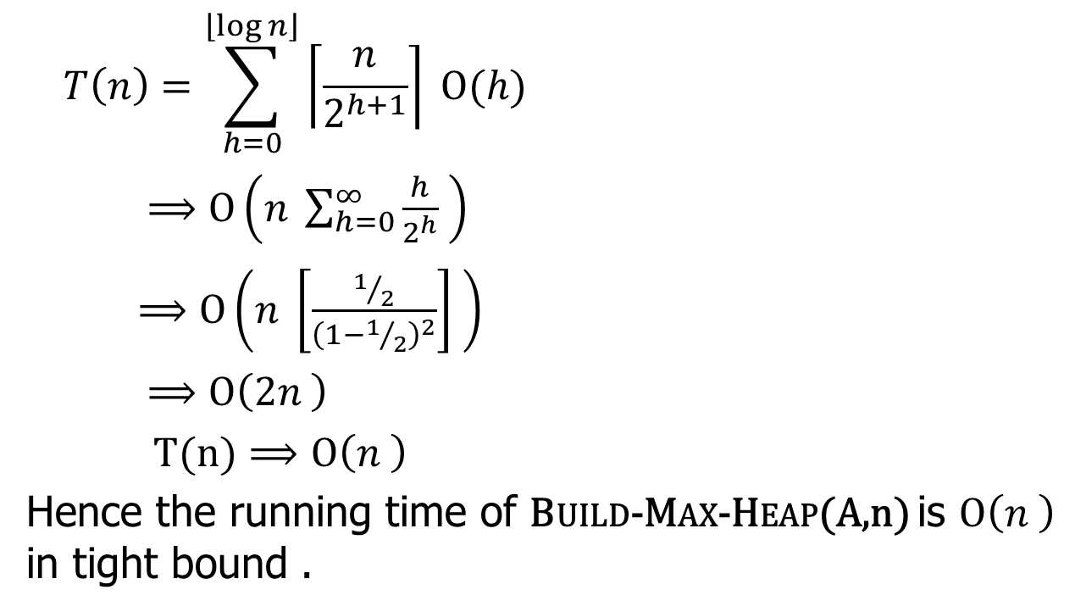
Tighter analysis Proof
$$T\left(n\right)=\sum_{h=0}^{\left\lfloor \log{n}\right\rfloor }{\left\lceil \frac{n}{2^{h+1}}\right\rceil }Ο(h)$$
$⟹Ο\left(n \sum_{h=0}^{∞}{\frac{h}{2^{h}} }\right)$
$⟹Ο\left(n \left[\frac{1/2}{{\left(1−1/2\right)}^{2}}\right] \right)$
$⟹Ο\left(2n \right)$
$T(n)⟹Ο\left(n \right)$
Hence the running time of Build-Max-Heap(A,n) is $Ο\left(n \right)$ in tight bound .

Slide 24
The heapsort algorithm
Given an input array, the heapsort algorithm acts as follows:
• Builds a max-heap from the array.
• Starting with the root (the maximum element), the algorithm places the maximum element into the correct place in the array by swapping it with the element in the last position in the array.
• “Discard” this last node (knowing that it is in its correct place) by decreasing the heap size, and calling MAX-HEAPIFY on the new (possibly incorrectly-placed) root.
• Repeat this “discarding” process until only one node (the smallest element) remains, and therefore is in the correct place in the array.

Slide 25
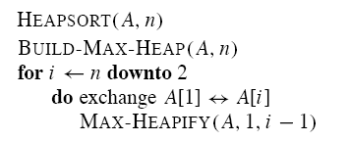

Slide 26
Example

Slide 27
Analysis
• BUILD-MAX-HEAP: O(n)
• for loop: n − 1 times
• exchange elements: O(1)
• MAX-HEAPIFY: O(lg n)
Total time: O(n lg n).

Slide 28
Heap implementation of priority queue
Heaps efficiently implement priority queues. These notes will deal with max priority queues implemented with max-heaps. Min-priority queues are implemented with min-heaps similarly.
A heap gives a good compromise between fast insertion but slow extraction and vice versa. Both operations take O(lg n) time.

Slide 29
Priority queue
Maintains a dynamic set S of elements.
• Each set element has a key-an associated value.
• Max-priority queue supports dynamic-set operations:
• INSERT(S, x): inserts element x into set S.
• MAXIMUM(S): returns element of S with largest key.
• EXTRACT-MAX(S): removes and returns element of S with largest key.
• INCREASE-KEY(S, x, k): increases value of element x’s key to k. Assume k ≥ x’s current key value.
• Example max-priority queue application: schedule jobs on shared computer.

Slide 30
• Min-priority queue supports similar operations:
• INSERT(S, x): inserts element x into set S.
• MINIMUM(S): returns element of S with smallest key.
• EXTRACT-MIN(S): removes and returns element of S with smallest key.
• DECREASE-KEY(S, x, k): decreases value of element x’s key to k. Assume k ≤ x’s current key value.
• Example min-priority queue application:
event - driven simulator.

Slide 31
Finding the maximum element
Getting the maximum element is easy: it’s the root.
HEAP-MAXIMUM(A)
return A[1]
Time: (1).

Slide 32
Extracting max element
Given the array A:
• Make sure heap is not empty.
• Make a copy of the maximum element (the root).
• Make the last node in the tree the new root.
• Re-heapify the heap, with one fewer node.
• Return the copy of the maximum element.
HEAP-EXTRACT-MAX(A, n)
if n < 1
then error .heap underflow.
max ← A[1]
A[1] ← A[n]
MAX-HEAPIFY(A, 1, n − 1) remakes heap
return max

Slide 33
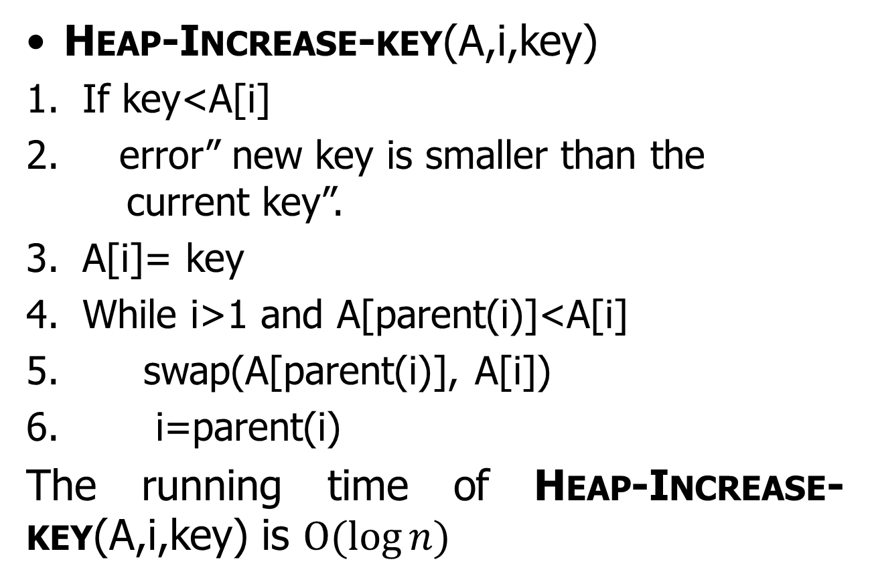
Heap-Increase-key(A,i,key)
If key<A[i]
error” new key is smaller than the current key”.
A[i]= key
While i>1 and A[parent(i)]<A[i]
swap(A[parent(i)], A[i])
i=parent(i)
The running time of Heap-Increase-key(A,i,key) is $Ο(\log{n)}$

Slide 34
Example

Slide 35
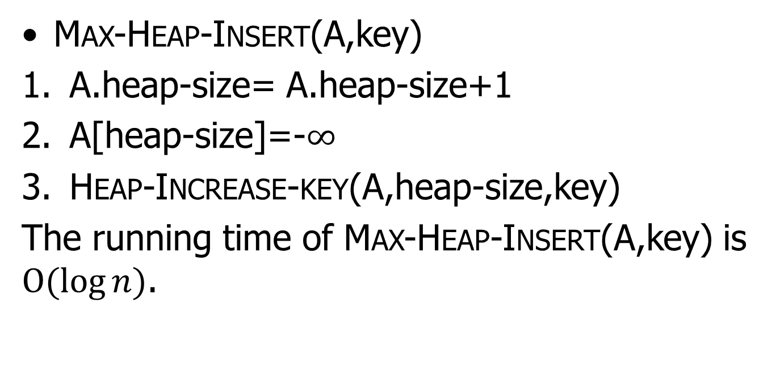
Max-Heap-Insert(A,key)
A.heap-size= A.heap-size+1
A[heap-size]=-$∞$
Heap-Increase-key(A,heap-size,key)
The running time of Max-Heap-Insert(A,key) is $Ο(\log{n)}$.

Slide 36

Thank U

